Slide 1
BMC COLLEGE OF ENGINEERING CSE DEPARTMENT
FIRST REVIEW → LEARNWORDS -VIRTUAL CLASSROOM
BATCH MEMBERS:
ASHISH S KOSHY
HELAN MARIYAM AIPE
SOJU MATHEW
SWATHISH KRISHNA
GUIDED BY:
Ms. ROSE MARY THOMAS

Slide 2
INTRODUCTION
Learnwords is based on powerful scientific visualization techniques and can be used as an effective aid in online virtual teaching.
The project deals with creation of a virtual classroom website which mainly focuses on the interaction of teacher-student relationship.
Comparing existing virtual platforms, this mainly rely on voice supporting facility and also helps in attaching and viewing documents.

Slide 3
LITERATURE SURVEY
Virtual reality classroom as an constructivist approach
This paper mainly focus on 3D model of classroom.
The learners enter the virtual model of the classroom of an avatar, navigate through it, zooms in or out he or she wishes changes his or her view point and perspective in the virtual world.

Slide 4
FIRST INTERNATIONAL CONFERENCE ON FUTURE GENERATION COMMUNICATION TECHNOLOGIES
A framework of virtual classroom framework model on the internet
It connects the advantage of existing offline approaches like a white board with advantages of life streaming systems with many participants.
The model of this basic virtual classroom is basis up on 4 main technologies itself. They are:
The flash media server architecture
The RTMP protocol
The client server connection flows &
The shared objects.

Slide 5
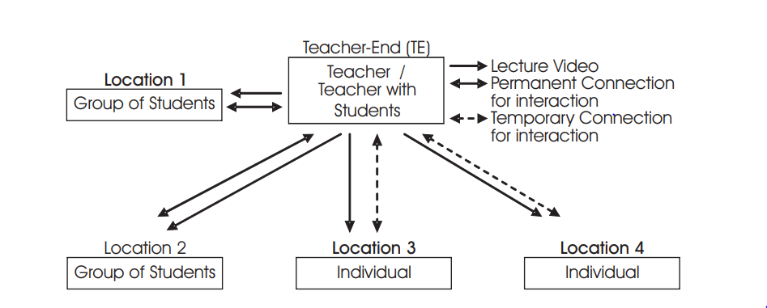
Layout of virtual teaching

Slide 6
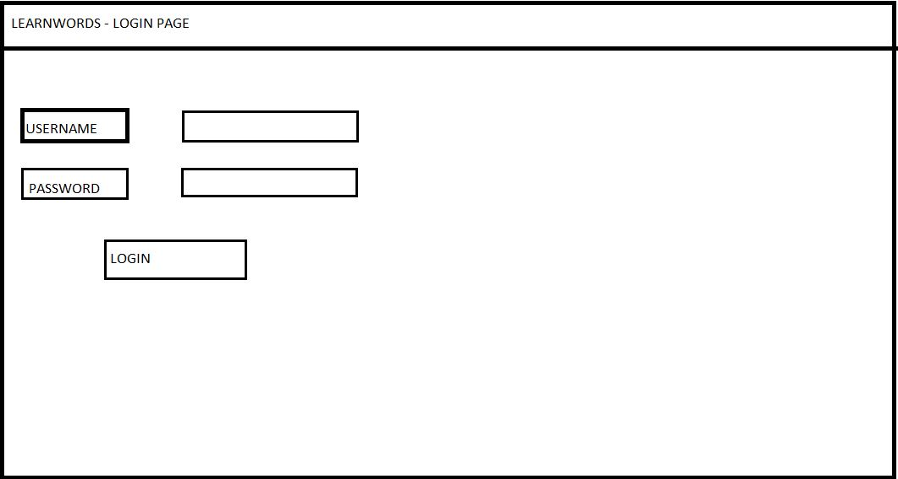
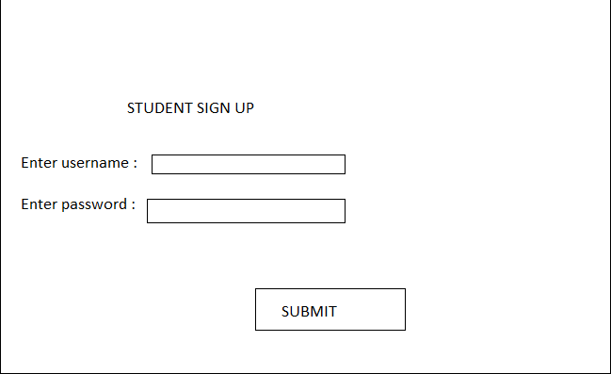
ARCHITECTURE DESIGN

Slide 7
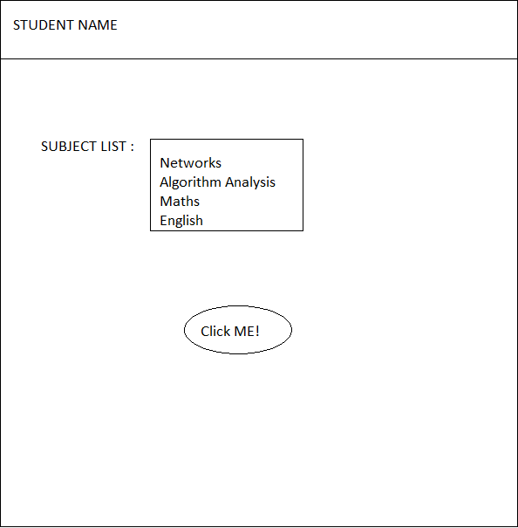
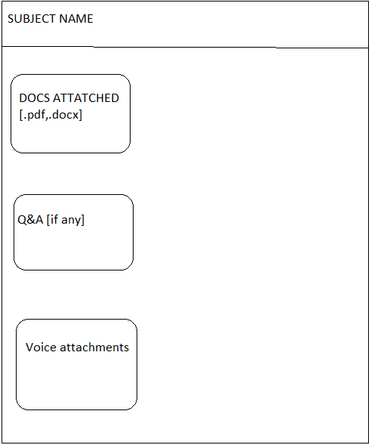

Slide 8
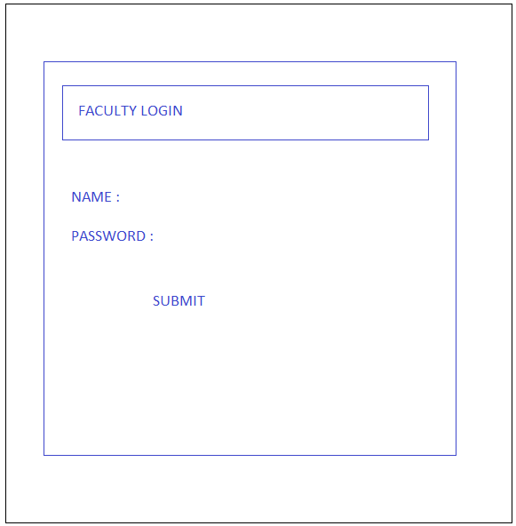
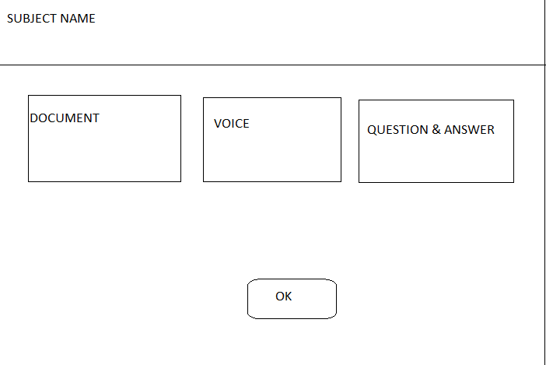
FACULTY PAGE DESIGN

Slide 9
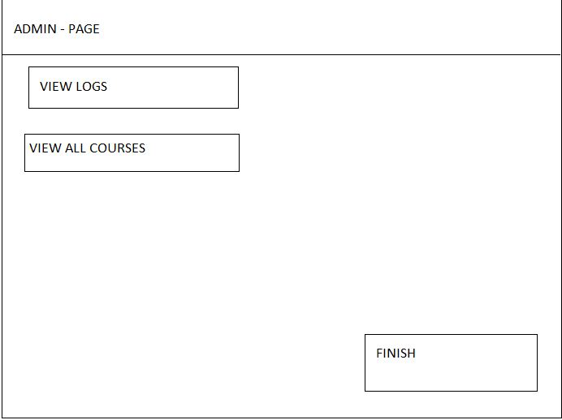
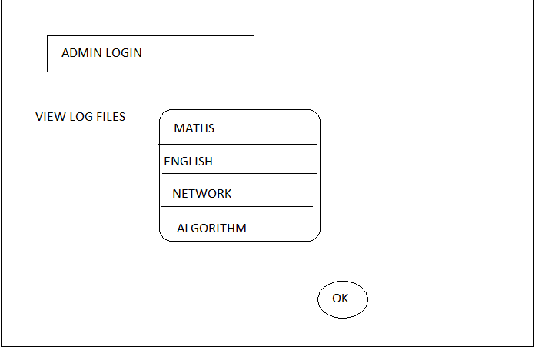
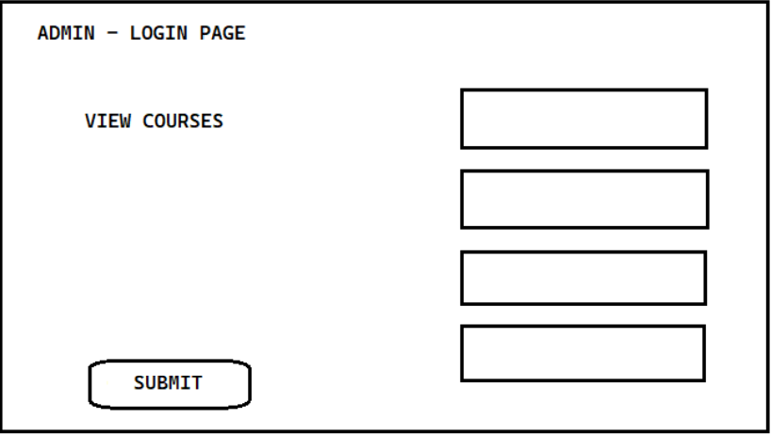
ADMIN PAGE LAYOUT

Slide 10
METHADOLOGY
Learnwords can be used and implemented by the respective students who has a username and password, stored in database.
After logging in, the student can access the facilities provided by the faculty.
If not signed up, enter username and password and submit.
The student can view the document files, hear the attached voice clippings of the respective faculty.

Slide 11
In the faculty login forum, faculty can login and attach documents, voice clippings of their respective subject.
In the admin page, the admin can view the log files as well the course list.
This mainly focus on virtual teaching along with question and answer session.
Student can ask questions and the answer can be uploaded by the respective faculty.

Slide 12
SOFTWARE AND HARDWARE REQUIREMENTS
SOFTWARE REQUIREMENTS
It is possible to implement this e-learning tool in windows using HTML,CSS AND JAVA [/JS] for frontend and SQL as database.

Slide 13
HARDWARE REQUIREMENTS
Monitor screen – the software shall display information to the user via the monitor screen
Mouse – the software shall interact with the movement of the mouse and the mouse buttons. The mouse shall activate areas for data input, command buttons and select options from menus.
Keyboard – the software shall interact with the keystrokes of the keyboard. The keyboard will input data into the active area of the database.

Slide 14
SRS TEMPLATE
C:\Users\Helan\Documents\Miniproject\learnwords\docs\SRS

Slide 15
SDD [SYSTEM DESIGN DOCUMENT]
C:\Users\Helan\Documents\Miniproject\learnwords\docs\SDD

Slide 16
EXPECTED OUTPUT
A virtual classroom with student interaction with their respective faculty enabling them to create a friendly approach through Q&A session, providing documents.
Moreover, it provides a voice attachment facility for communication.

Slide 17

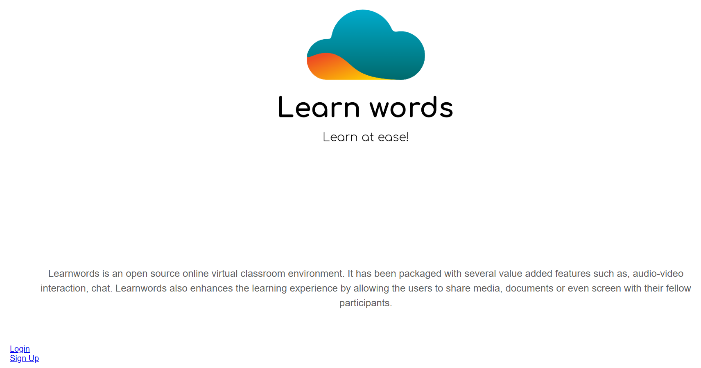
DESIGN LEVEL

Slide 18
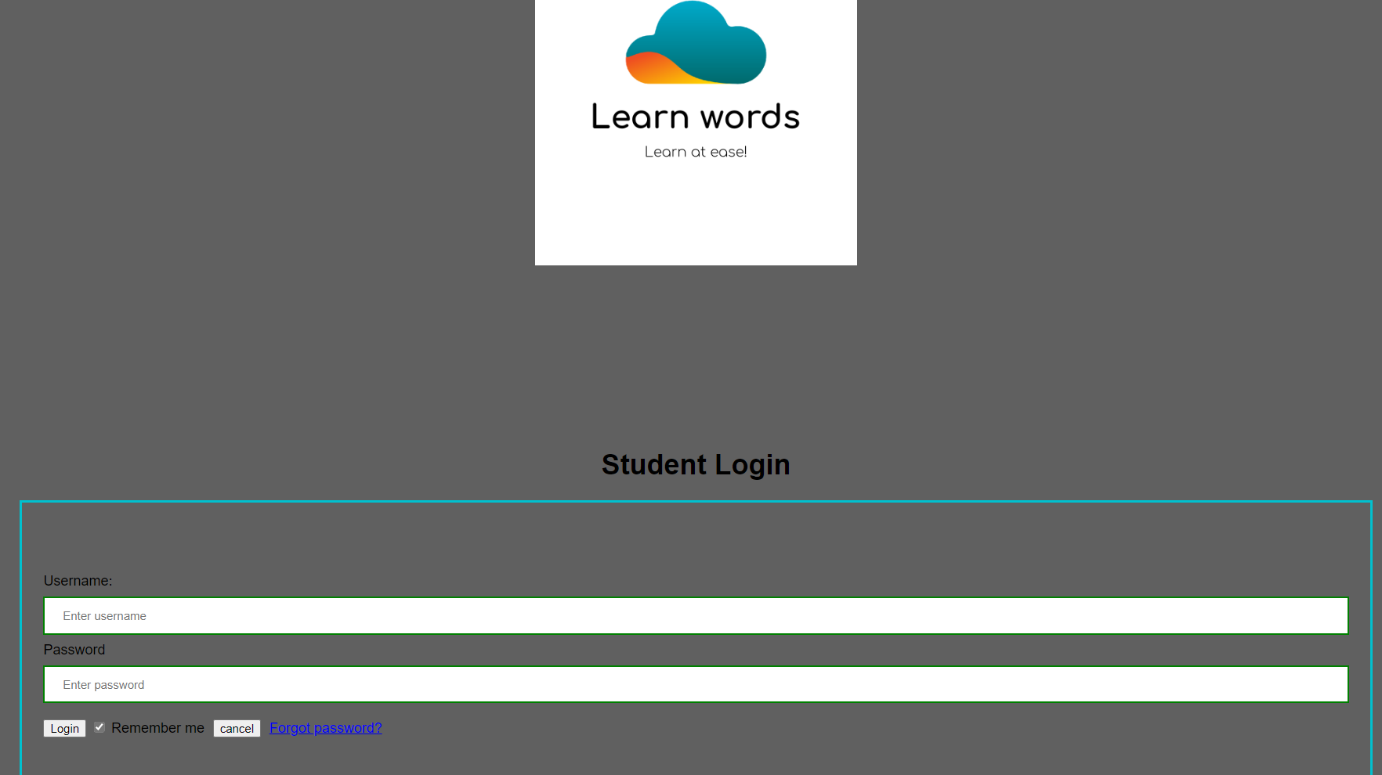

Slide 19
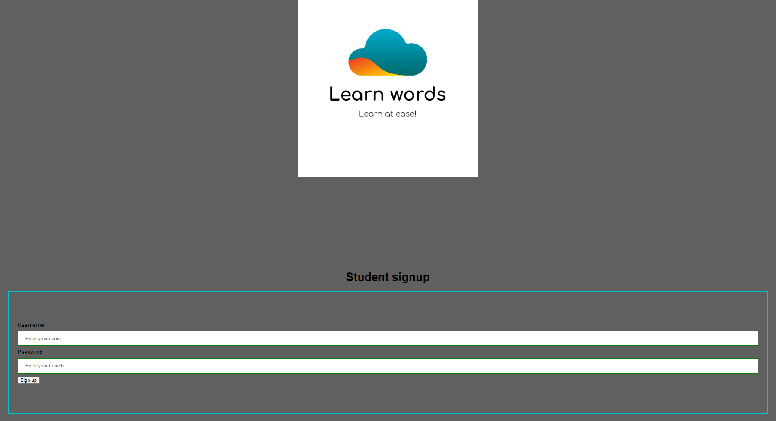

Slide 20
REFERENCE
International Journal of Virtual and Personal Learning Environments (IJVPLE): 1947-8518, 1947-8526: Education Journals | IGI Global (igi-global.com)
Gaurav Chadha and S.M. Nafay Kumail (2002). E-Learning-An Expression of the knowledge economy: A highway between concepts and practice. Tata McGraw Hill Publishing Company.

Slide 21
THANK YOU…!

